Slide 1


Round 1
The Year That Was....

Slide 2

Question 1 - December
In December 2014 Sony suffered a serious breach of their IT systems. In the emails that were hacked, who was described by film executives as ‘a minimally talented spoilt brat'?

Slide 3

Question 2 - January
With whom was Sam Smith forced to share the writing credits for his Grammy-nominated single ‘Stay With Me’?

Slide 4

Question 3 - February
Name the controversial film, directed by Sam Taylor-Johnson and starring the daughter of Melanie Griffith released in this month.

Slide 5

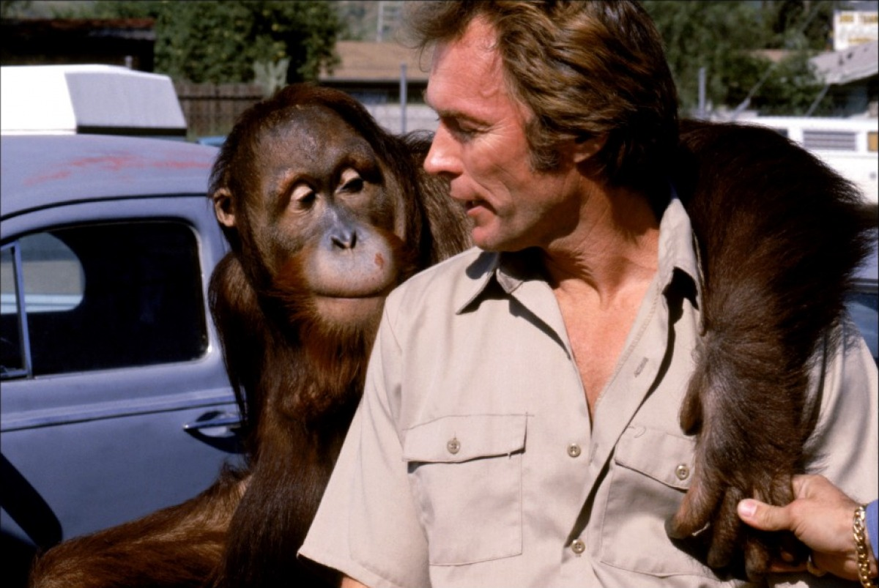
Question 4 - March
Who did Oisin Tymon have a falling-out with this month?

Slide 6

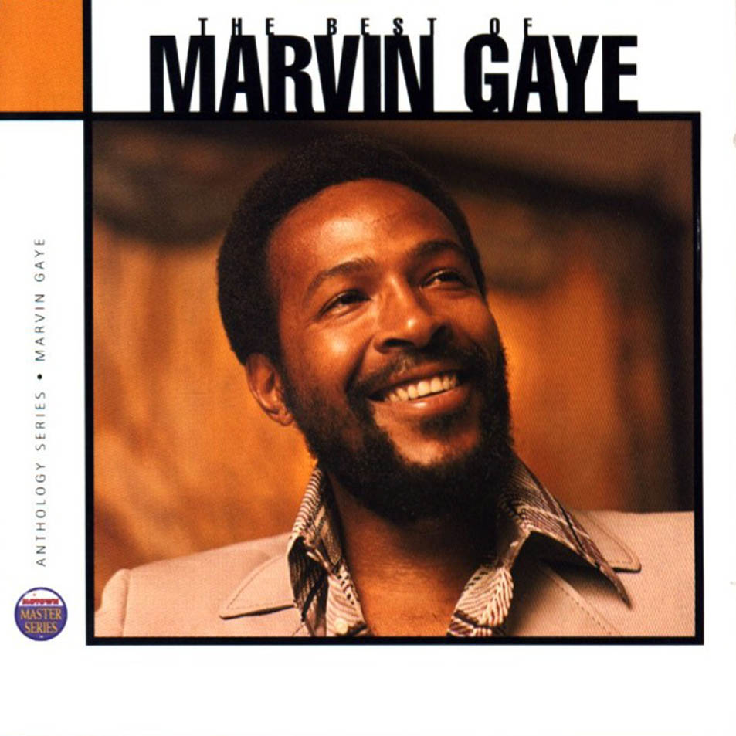
Question 5 - April
Giant pandas Xi Mei and Lu Lu broke the record for what?

Slide 7
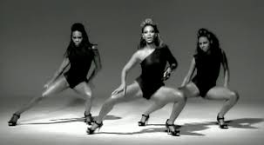
Question 6 - May
More than 60% of the Irish population said ‘Yes’ to what this month?

Slide 8
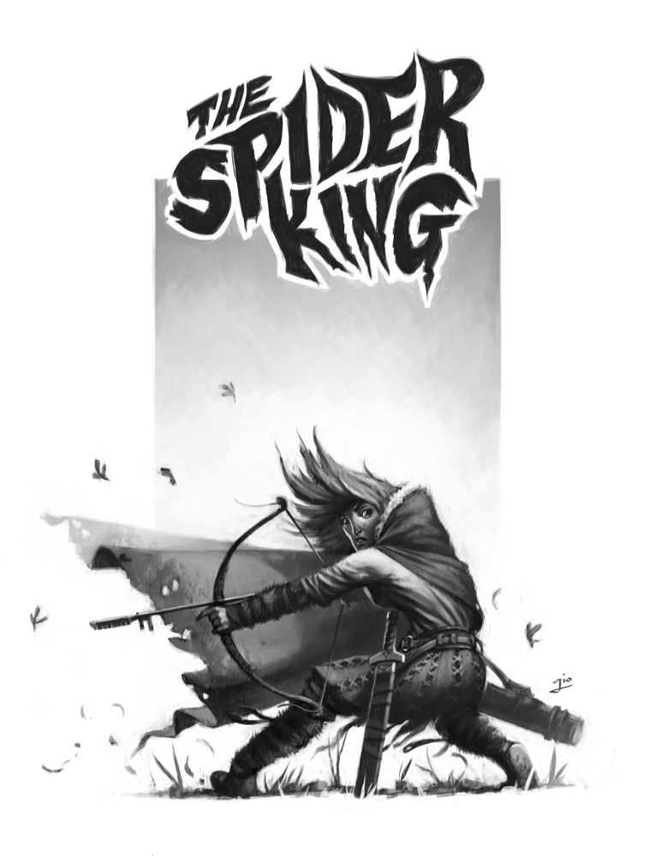


Question 7 - June
Name the author of the so-called ‘Black Spider Memos’.

Slide 9


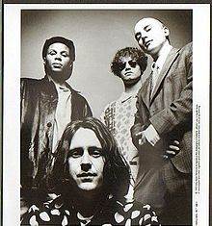
Question 8 - July
Which 89 year old author’s book entitled ‘Go Set a Watchman’ was published this month?

Slide 10


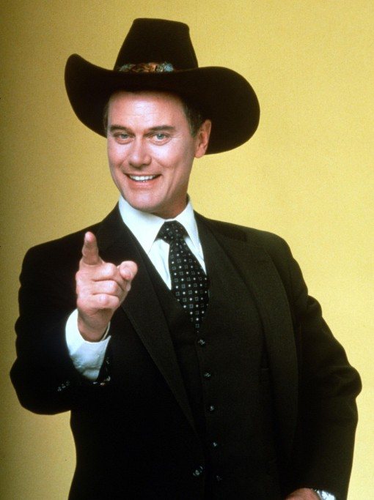
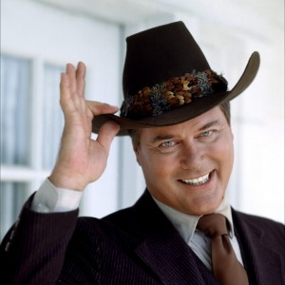
Question 9 - August
Who shot Cecil?

Slide 11

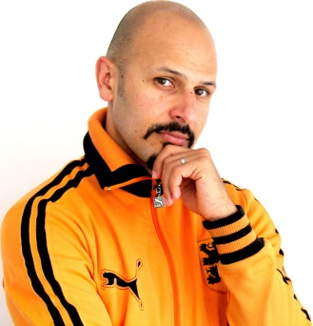


Question 10 - September
The new series of Downton Abbey caused a flood of complaints to ITV after it’s first episode. Why?

